Slide 1

EDT 210 - Visual Thinking

Slide 2
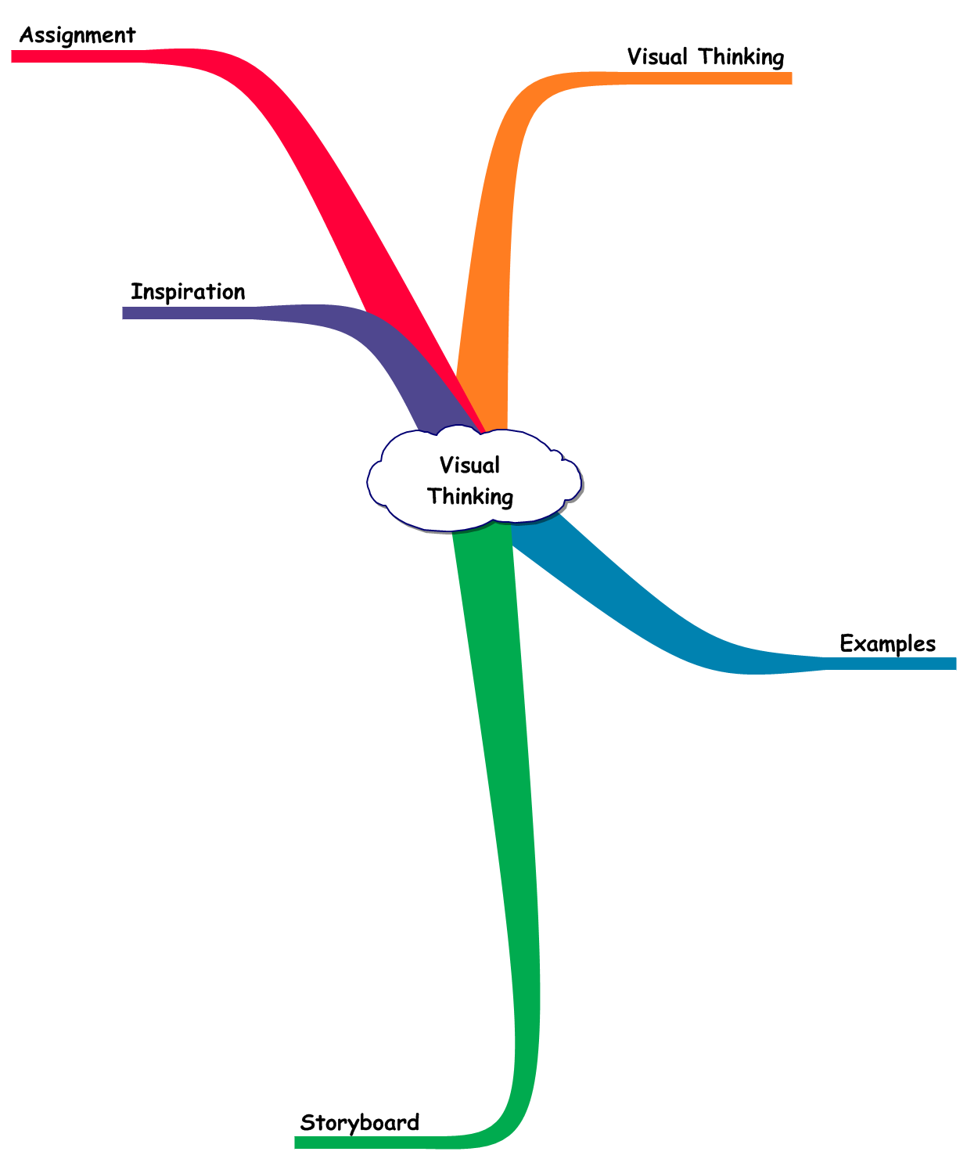
Visual
Thinking
Lesson
Map

Slide 3
Visual Thinking Agenda
Visual Thinking
Examples
Storyboard
Inspiration
Assignment

Slide 4
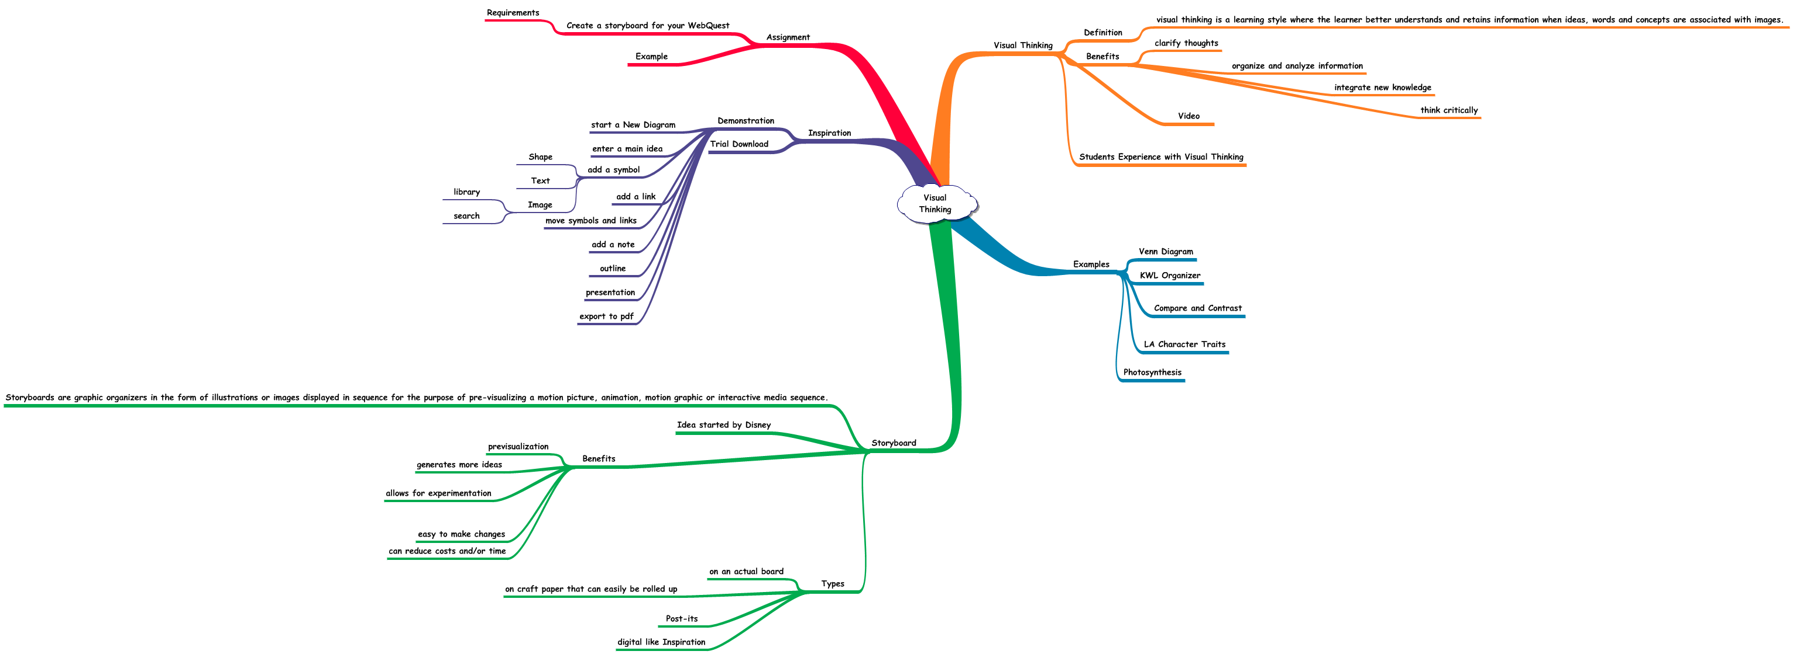
Visual Thinking Lesson Map

Slide 5
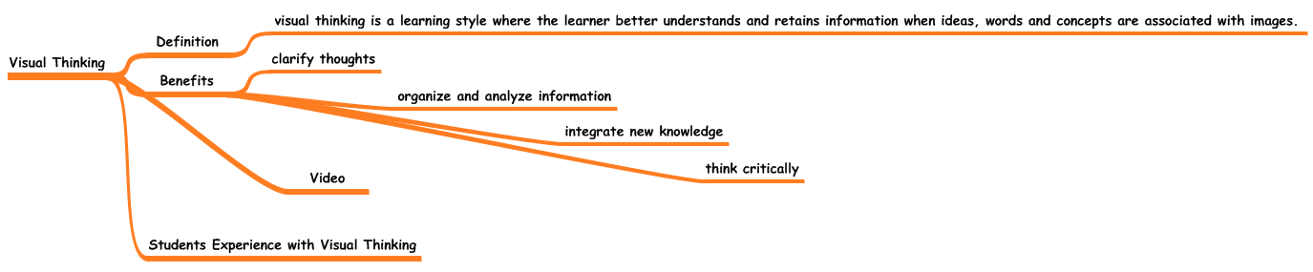
Visual Thinking Map

Slide 6
Visual Thinking Definition
Visual thinking is a learning style where the learner better understands and retains information when ideas, words and concepts are associated with images.
Notes:
Definition
Visual thinking is a learning style where the learner better understands and retains information when ideas, words and concepts are associated with images.
visual thinking is a learning style where the learner better understands and retains information when ideas, words and concepts are associated with images.
Benefits
Visual learning helps students clarify their thoughts
Students see how ideas are connected and realize how information can be grouped and organized. With visual learning, new concepts are more thoroughly and easily understood when they are linked to prior knowledge.
Visual learning helps students organize and analyze information
Students can use diagrams and plots to display large amounts of information in ways that are easy to understand and help reveal relationships and patterns.
Visual learning helps students integrate new knowledge
According to research, students better remember information when it is represented and learned both visually and verbally.
Visual learning helps students think critically
Linked verbal and visual information helps students make connections, understand relationships and recall related details.
clarify thoughts
organize and analyze information
integrate new knowledge
think critically
Students Experience with Visual Thinking

Slide 7
Visual Thinking Benefits
Clarify thoughts
Organize and analyze information
Integrate new knowledge
Think critically
Notes:
Definition
Visual thinking is a learning style where the learner better understands and retains information when ideas, words and concepts are associated with images.
visual thinking is a learning style where the learner better understands and retains information when ideas, words and concepts are associated with images.
Benefits
Visual learning helps students clarify their thoughts
Students see how ideas are connected and realize how information can be grouped and organized. With visual learning, new concepts are more thoroughly and easily understood when they are linked to prior knowledge.
Visual learning helps students organize and analyze information
Students can use diagrams and plots to display large amounts of information in ways that are easy to understand and help reveal relationships and patterns.
Visual learning helps students integrate new knowledge
According to research, students better remember information when it is represented and learned both visually and verbally.
Visual learning helps students think critically
Linked verbal and visual information helps students make connections, understand relationships and recall related details.
clarify thoughts
organize and analyze information
integrate new knowledge
think critically
Students Experience with Visual Thinking

Slide 8
Visual Thinking Video
http://www.thinkingfoundation.org/video/clips/mtairy-1st-org-thinking.html

Slide 9
Visual Thinking Student Experience

Slide 10
Visual Thinking Examples
Venn Diagram
KWL Organizer
Compare and Contrast
Verb Forms
LA Character Traits
Photosynthesis

Slide 11
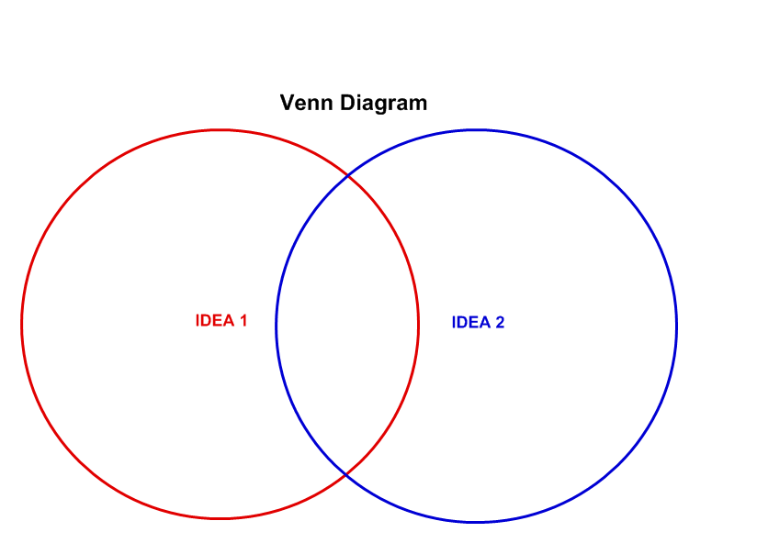
Venn Diagram

Slide 12
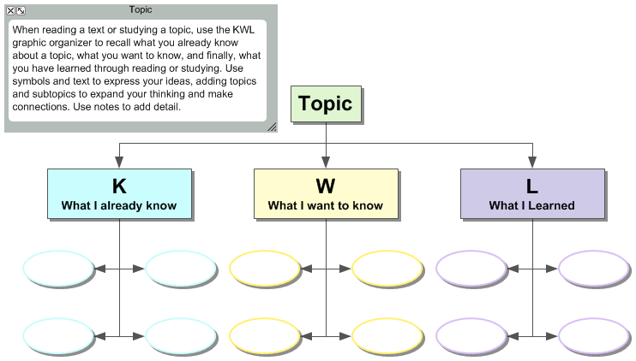
KWL Organizer

Slide 13
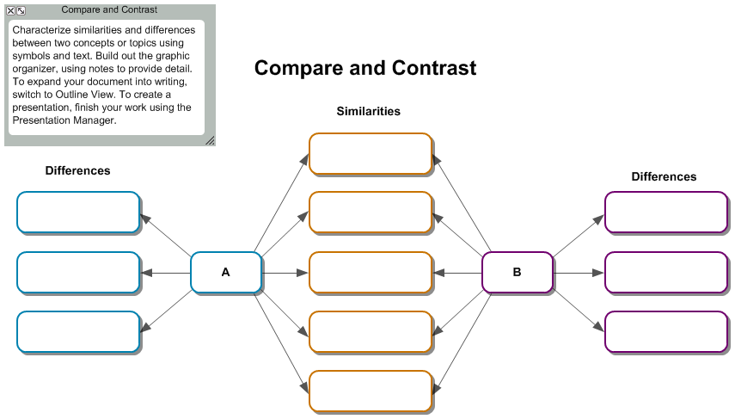
Compare and Contrast

Slide 14
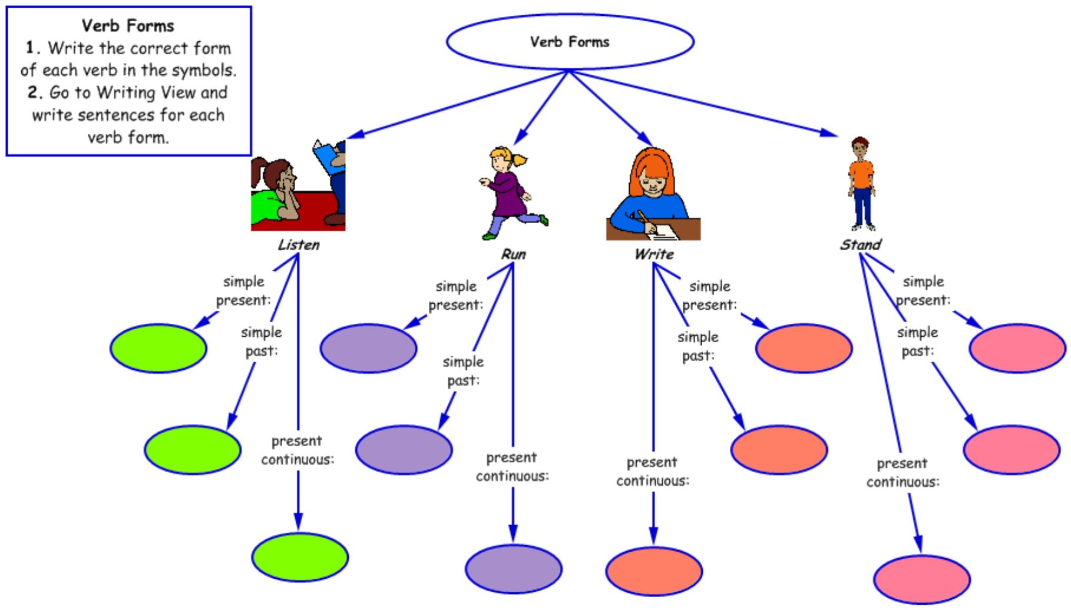
Verb Forms

Slide 15
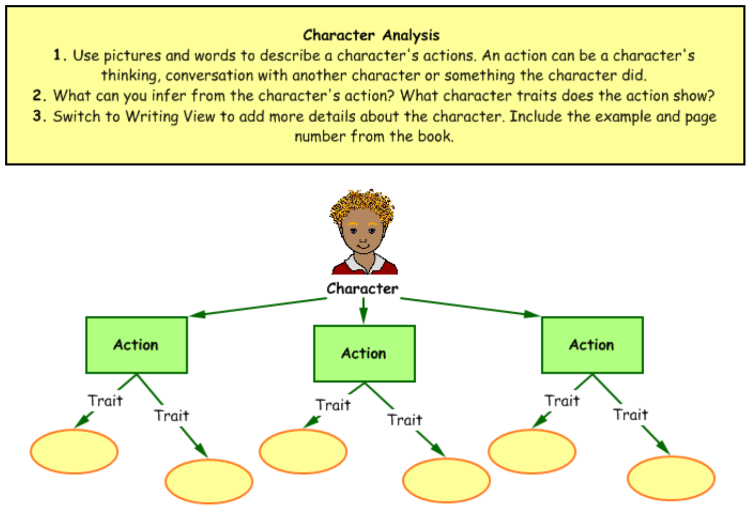
Character Traits

Slide 16
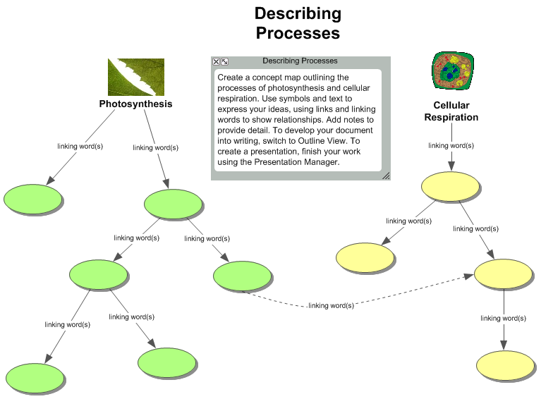
Photosynthesis

Slide 17
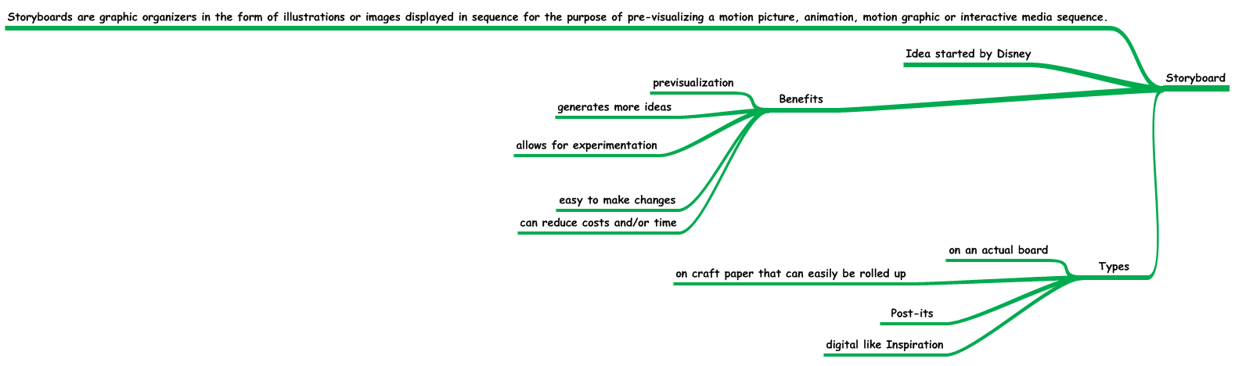
Storyboard Map

Slide 18
Storyboard Definition
Storyboards are graphic organizers in the form of illustrations or images displayed in sequence for the purpose of pre-visualizing a motion picture, animation, motion graphic or interactive media sequence
Idea started by Disney

Slide 19
Storyboard Benefits
Previsualization
Generates more ideas
Allows for experimentation
Easy to make changes
Can reduce costs and/or time

Slide 20
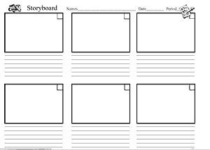
Storyboard Template Example

Slide 21
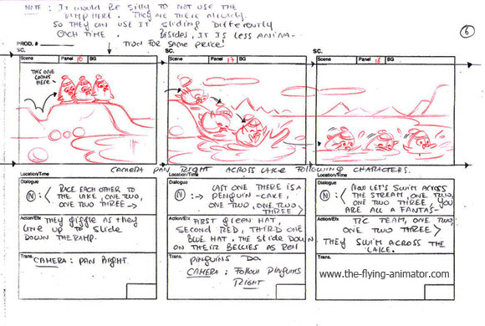
Storyboard Example

Slide 22
Storyboard Types
On an actual board
On craft paper that can easily be rolled up
Post-its
Digital like Inspiration

Slide 23
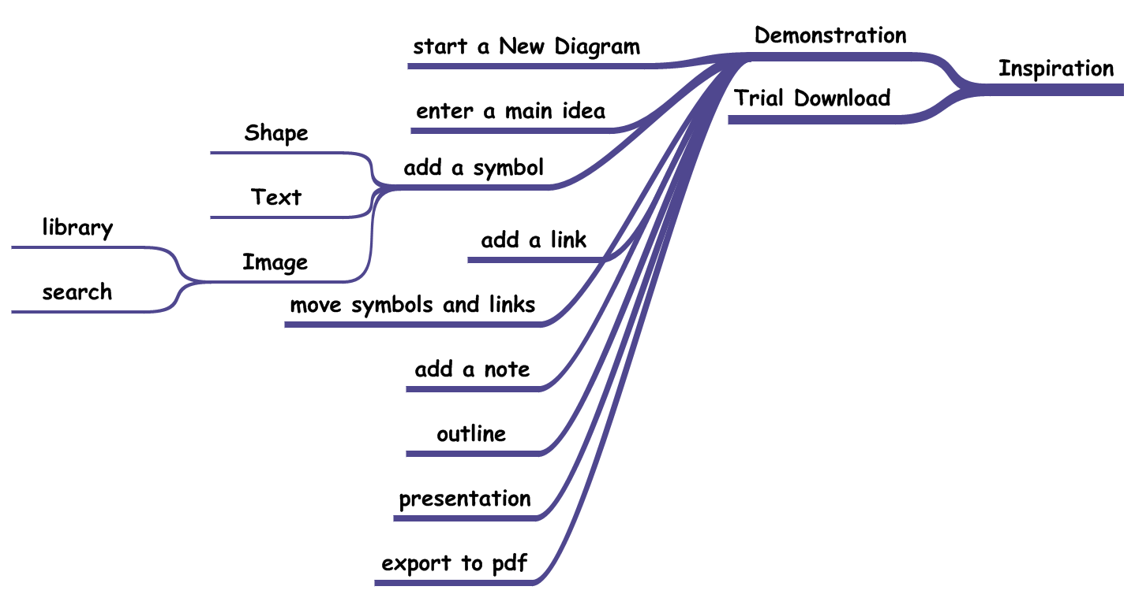
Inspiration Map

Slide 24
Inspiration Demonstration
Start a new diagram
Enter a main idea
Add a symbol
  Shape
  Text
  Image
    Library
    Search

Slide 25
Inspiration Demonstration continued
Add a link
Move symbols and links
Add a note
Add a hyperlink
Outline
Presentation
Export to pdf

Slide 26
Trial Download
Inspiration 9 - 30 day trial
Kidspiration

Slide 27
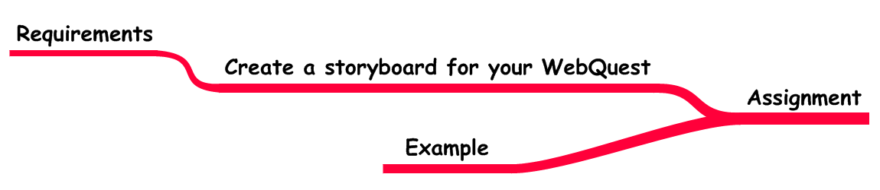
Assignment Map

Slide 28
Assignment - WebQuest Storyboard
Requirements
  Topic
  Grade Level
  Task
  Process (minimum of 10 steps)
  Resources (minimum of 5 hyperlinked)
    3 websites
    1 video
    1 extra (game, video, additional website, etc.)

Slide 29
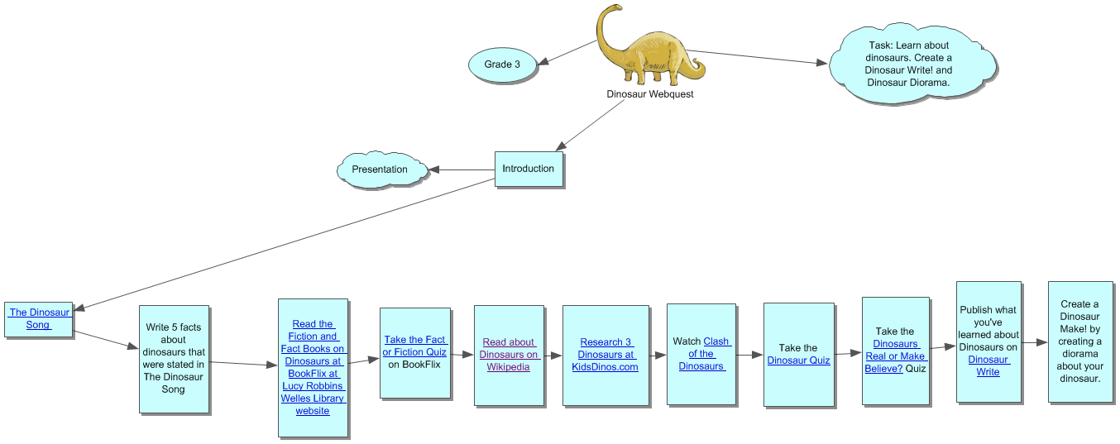
Assignment Example

Slide 30
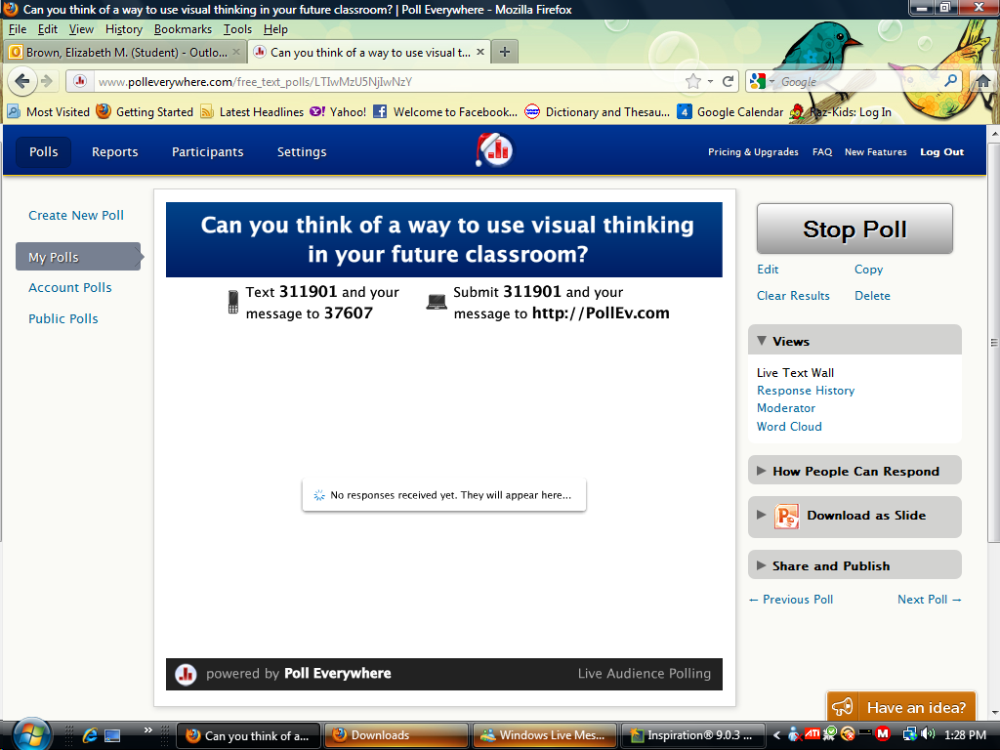
Integration Ideas - Pollanywhere.com

Slide 31
Image Credits
Blank Storyboard - http://dstmoviemaker.wikispaces.com/05+Story+board+templates

